Slide 1

Predicting customer buying behaviour
13/06/2024

Slide 2
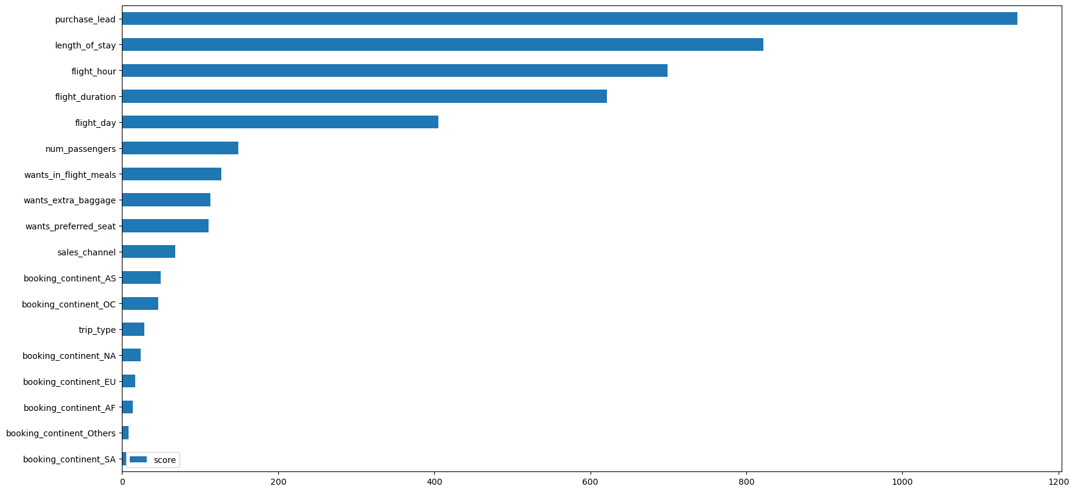
predictive model to understand factors that influence buying behaviour
Accuracy (Test Set): 0.80 Precision (Test Set): 0.30 Recall (Test Set): 0.22 F1-Score (Test Set): 0.25 roc_auc (test-proba): 0.56 roc_auc (train-proba): 0.99
The top 5 features in the chart based on importance scores are:
purchase_lead
length_of_stay
flight_hour
flight_duration
flight_day
We have trained the data set with Random forest classifier model and received
ACCURACY: 85.09
AUC score: 0.558
route
booking_origin
flight_duration
wants_extra_baggage
length_of_stay
are the top 5 features which influence
Customer buying behavior
We need to increase the AUC score.
Accuracy (Test Set): 0.80 Precision (Test Set): 0.30 Recall (Test Set): 0.22 F1-Score (Test Set): 0.25 roc_auc (test-proba): 0.56 roc_auc (train-proba): 0.99

